Slide 1
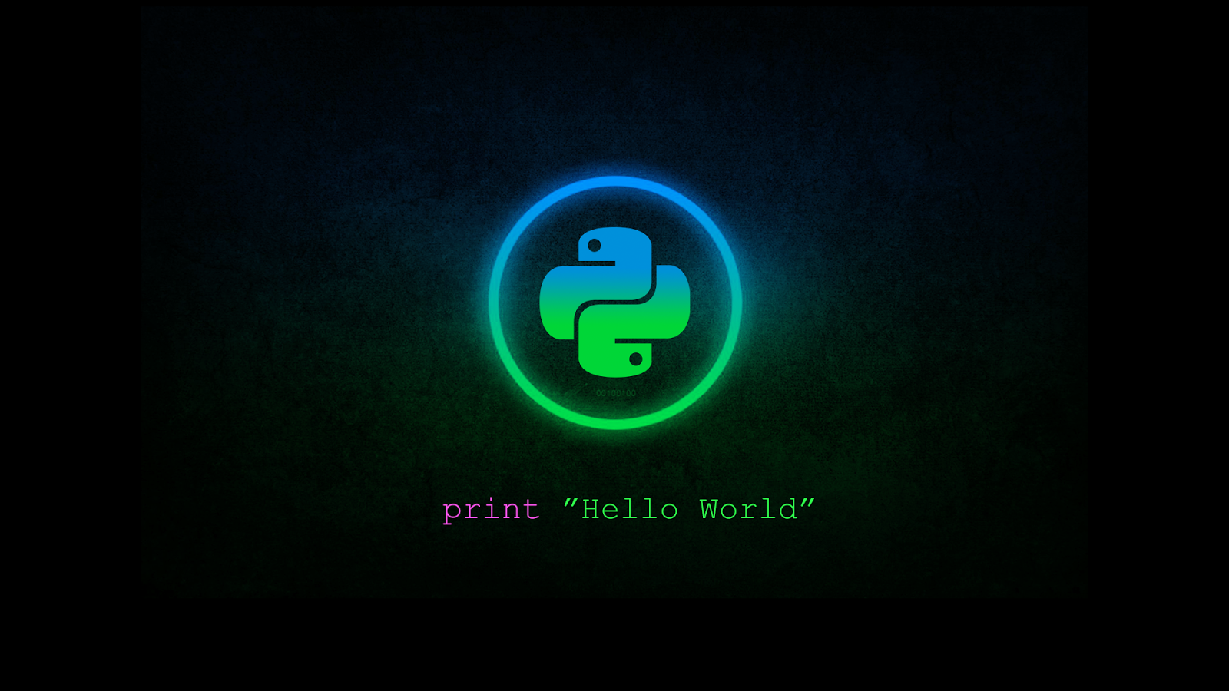

Python for Penetration Testing
The Academy: Article III

Slide 2
Introduction
This will be one of the more interactive workshops.
If you have a Linux environment available, whether it be from dual-booting, WSL, or even a VM, please turn it on.
We will be using Python 3 to develop a couple beginner tools that you can use to buff your portfolio and develop a Cybersecurity development skillset!
This can also be used to further your progress towards Malware Development/Analysis, DevOps, Data Science, System Administration and Networking careers in the future.

Slide 3

Use Cases
Python is the most important language to know if you plan to pursue a Security-focused career, whether hands on or technical. As professionals, we will use it to:
Develop network assessment tools on-the-fly with Scapy
Perform and manage exploitation using PwnTools and Sockets
Scrape, parse, and attack websites with Requests and bs4
...and much more!

Slide 4

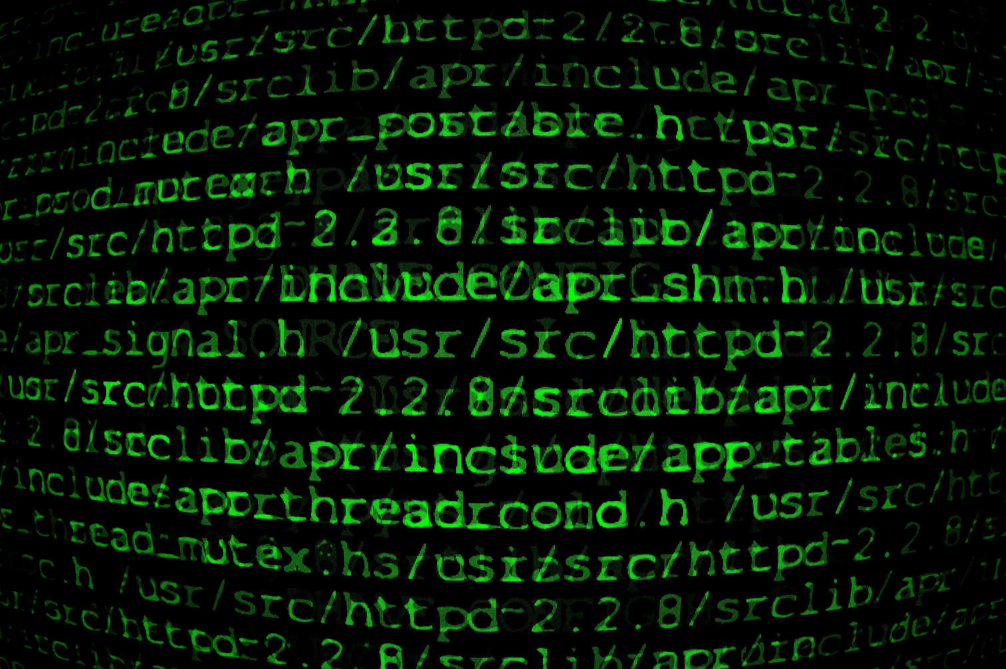
What We'll Develop!
Today we aim to create:
Basic Reverse Shell
File Transfer Applet
Host Discovery Tool
Then, we'll explore some interesting tips and tricks!

Slide 5

The most basic reverse shell
Subprocess and Sockets

Slide 6
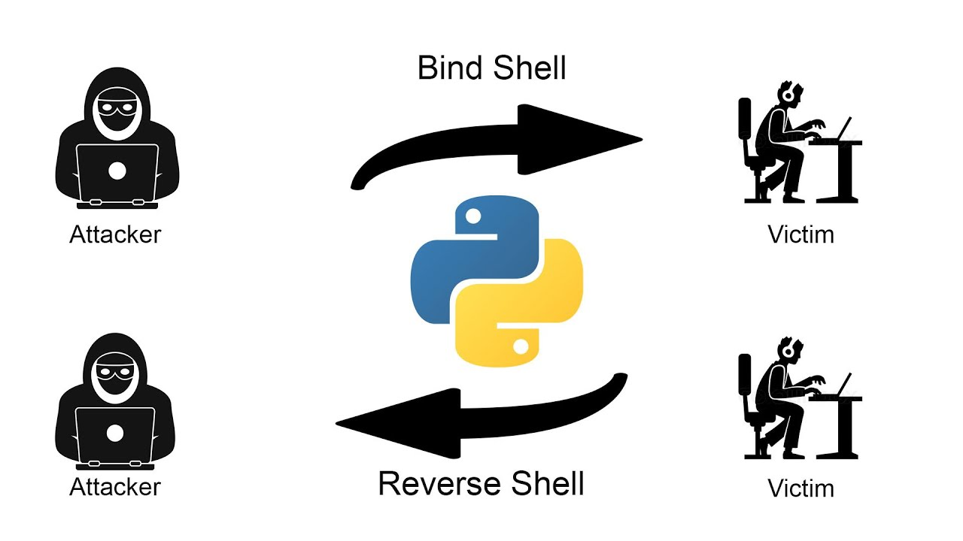
First, we must familiarize ourselves with Sockets.
We use sockets every single day!

Slide 7
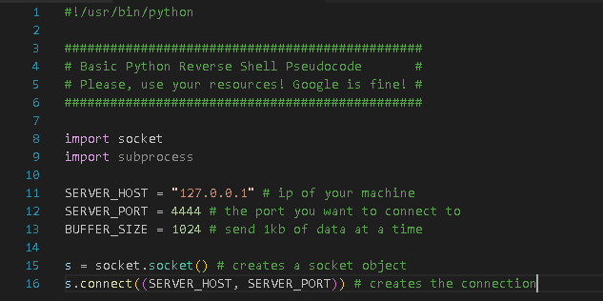
Client-Side Sockets!
We won't have to worry about server-side sockets during this demo.
The only two modules we will require are:
Socket
Subprocess (don’t worry, we'll get here)
First, we will put the information we will use for the connection.
Then, we'll add the functions for a standard connection.

Slide 8
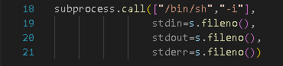
The Command Loop!
Next, we will develop the bash shell!
We will let subprocess handle the hard part.
Use subprocess.call() to spawn a bash shell, then force that shell to use the socket as stdout, stderr, and stdin.

Slide 9
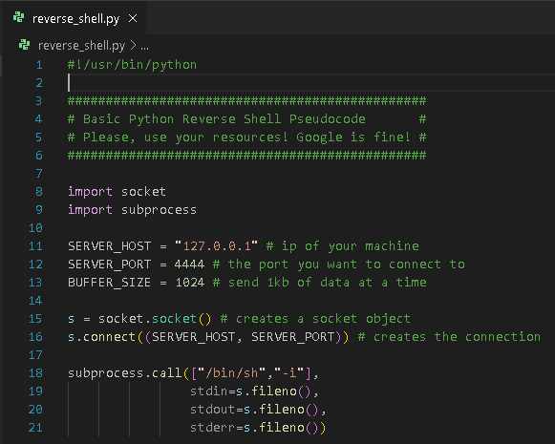
The Final Product! To Test: Open a terminal and run: nc –nlvp 4444 In Another tab, run the python script. If it works, you did everything right!
This is what your complete code should look like. Try it yourself!

Slide 10

File transfer applet
Utilizing python sockets to extract information during a penetration test.

Slide 11
Writing the File Transfer Script
Parse Args
First, we will use the Python module ArgParse to collect our filename, the "server's" IP address, and the port we want to communicate with.
Get File
Then, we will make a function where we test if the file exists and attempt to open it, before returning its contents as a string.
Open Connection
Next, we create the socket connection the same way we did before.
Send File
Now, rather than using subprocess, we will use the socket send() function to transmit the file's contents over the connection.
Close Connection
Finally, we'll close the connection and exit gracefully.

Slide 12
Now to VS Code!
I encourage you to also look at the documentation for every library we use and find ways to enhance or modify my example to suit your needs or improve upon it as a project!

Slide 13
Why would we use these?
Reverse Shell
File Transfer
Allows you to gain a stable command shell on a victim's machine.
The more minimal it is, the less likely it is to be detected.
Expand upon the knowledge we gain when writing shells to develop Command and Control frameworks, exploits, and many other tools.
We can manually control every aspect of our communication with socket.
Allows us to transfer files, keys, secrets, and more in a lightweight applet.
Although its barebones, it can be expanded to perform these actions completely discreetly with encryption, proxies, fragmentation, etc.
It can be developed quickly and deployed anywhere that has Python.

Slide 14

Host discovery
Using ARP and TCP SYN with Python-Scapy.

Slide 15
Intro to Scapy
Scapy is powerful network monitoring and packet manipulation module in Python. It can be used to develop a lot of low-level projects like passive host discovery scans, Bluetooth sniffing, Wi-Fi sniffing, device spoofing, Man-In-The-Middle, and much much more!
In this demo, we are going to make a host discovery tool using two different methods:
ARP scanning, which is the fastest and most reliable way of scanning for hosts due to being extremely low-level.
TCP Syn/Ack scanning, which allows us to forge normal traffic and use the response to gauge if the device is online.

Slide 16
Creating the Host Discovery Tool!
Parse Args
We will use ArgParse yet again to determine which type of scans we will perform.
Arp Scan
We will scan all devices with a blank ARP packet just to see who responds.
TCP Syn Scan
Like the ARP scan, we will probe the network with TCP Syn packets and see who responds with an ACK packet.
Parse Output
Finally, we will obtain the output from the scan and print it in a user-friendly format!

Slide 17
Importance of Reconnaisance
Lessens Unnecessary Noise during Scans
Creates Priority
Being Careful
Port Scanning and Vulnerability Scanning are essential steps in the Pentesting process. By narrowing down the list of hosts, you allow yourself to waste less time and resources while also being less suspicious.
By identifying machines and conducting scanning, you can determine what assets you need to prioritize when conducting your research and enumeration. The deployments most likely to bear critical vulnerabilities are noted.
It is essential that you don't neglect this stage of the Pentesting lifecycle; if you narrow too far you might miss a critical environment, but if you don't narrow enough, you make more noise and focus too much on unimportant infrastructure.

Slide 18

Tips outlook & Conclusion

Slide 19
Tips & Tricks
I HEAVILY encourage you to write your own projects, whether you use the libraries we looked in to today or not. Submit them via my discord for a chance to get posted in the announcements channel!
Libraries to look in to:
Pwntools
Scapy
Socket
BeautifulSoup4
Requests
Also, if you can, acquire this book: Red Team Field Manual by Ben Clark.
Use cheatsheets and docs to your advantage!

Slide 20
My Current Python Projects
GOTHAM!
hARPer
Pilgrim
Hyper-sensitive system integrity monitor
Features socket detection and Malicious process detection algorithms
Filesystem monitoring
ARP Spoofing
Man-In-The-Middle
Able to throttle connections at will
Host discovery for automatic targeting
Fileless exploitation and malware deployment
Living-Off-The-Land
Can be expanded upon for larger malware campaigns and research

Slide 21

Summary
Python has been a language required by employers universally since its inception and this trend is even more evident within the Security field. I hope this training demonstrated just how necessary the language is and that it inspired you to want to push the boundaries of development the way I have wanted to over the years.
By finishing this workshop, you have taken a large technical step towards a Cybersecurity career and we hope to get more and more in depth as the semester continutes!

Slide 22

Next up... Basic security concepts
Studying CompTIA Sec+ Curriculum and Going Over the Importance of Certifications in the Career Search

Slide 23

THANK YOU
Diante Jackson
diante.jackson@proton.me
https://github.com/diante0x7

